Slide 1
Revolutionizing E-commerce in Ilorin
A Comprehensive Plan for Success

Slide 2
Introduction
Welcome: Thank you for joining us. We appreciate your time and interest.
Purpose of the Presentation
Today, we will present our comprehensive plan to revolutionize food delivery in Ilorin.
We aim to demonstrate the market potential, our unique business model, and the positive impact our service will have on the community.
We will also highlight the benefits of investing in our venture and our strategy for ensuring sustainable growth and success.

Slide 3
Project Vision
Vision Statement
We aim to create a seamless experience for our users starting from the students entreprenuers(sellers) and buyers. By focusing on user needs and preferences, we will deliver a service that exceeds expectations.
Enhance Customer Convenience
Make ordering as easy and convenient as possible.
We will develop an intuitive website that allows users to place orders with just a few clicks. Features such as real-time tracking and multiple payment options will add to the convenience.

Slide 4
Support Students/firm business owners
Partner with Students/f to expand their reach and increase sales.
Our platform will help local restaurants gain visibility and access a larger customer base. We will provide tools and support to help them manage orders efficiently.
Ensure Timely and Safe Deliveries
Guarantee fast and safe delivery of orders.
We will implement optimized delivery routes and use advanced logistics to minimize delivery times. Strict hygiene and safety protocols will be in place to ensure the safe handling of an order."

Slide 5
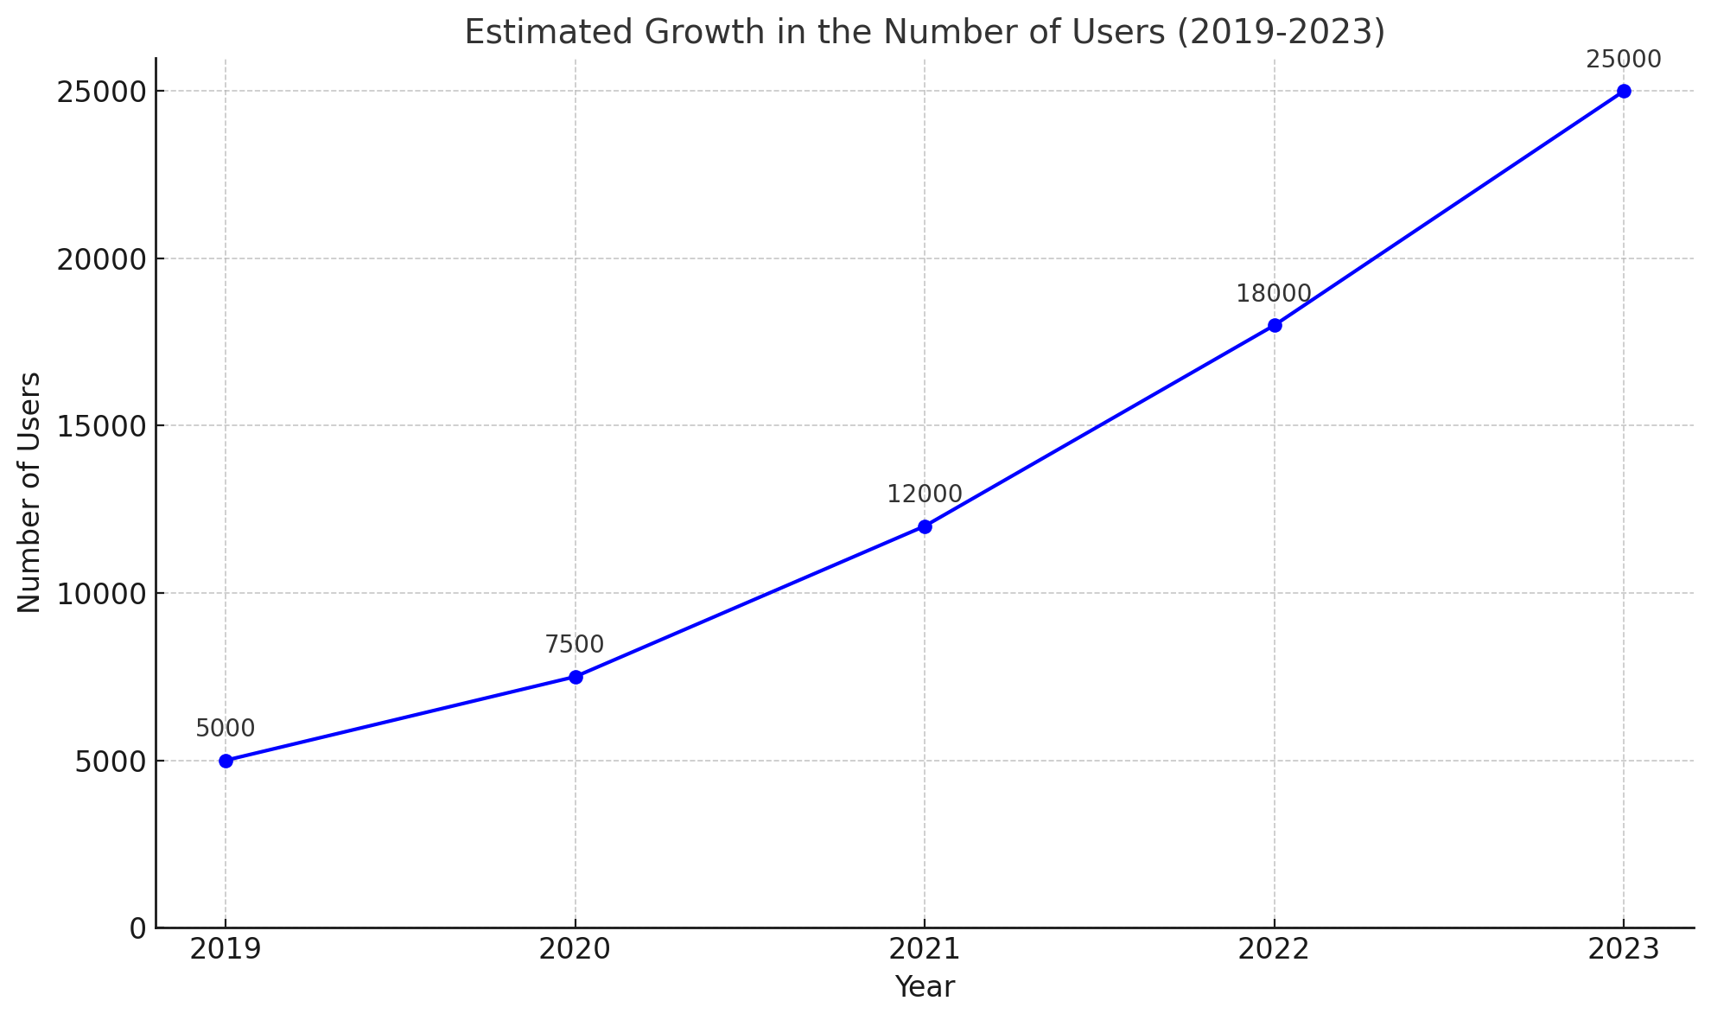
Market Opportunity
Growing Demand
Increasing demand for food delivery services
With the rise of digital technology and changing consumer habits, there has been a significant increase in the demand for convenient product delivery services globally.

Slide 6
Untapped Market
The lack of a comprehensive delivery seystem in Ilorin
Despite the growing demand, Ilorin lacks a comprehensive delivery service that meets modern standards and customer expectations. This presents a unique opportunity to fill this gap, but for now as a start up our main target are our fellow students in the University of Ilorin.
Potential User Base
Estimate the number of potential users at University of Ilorin
With a student population of over 60,000 at Unilorin, there is a substantial and concentrated user base that can drive early adoption and sustained usage of our service.

Slide 7
Market Research
Note: this research was mostly based on how students orders fastfood on Campus
Objectives
Understand Demand: Assess the level of interest and frequency of food delivery among the Unilorin community.
Identify Competitors: Determine existing delivery services in Ilorin and their market share.
Determine Customer Preferences: Discover preferred cuisines, ordering habits, and price sensitivity.
Evaluate Operational Feasibility: Evaluate logistical considerations and potential challenges in delivering to the Unilorin area.

Slide 8
Methods:
Surveys: Distributed both online (social media, university forums) and offline (flyers, campus events).
Interviews: Conducted in-depth interviews with students and staff to gather qualitative insights.
Secondary Data: Analyzed existing market reports, academic studies, and industry publications relevant to food delivery services.
Observational Research: Observed current food delivery practices and peak times around the campus to understand demand patterns.

Slide 9
Key Findings:
Demand Insights:
Frequency of Orders: Approximately 60% of respondents order food delivery at least once a week.
Peak Times: Highest demand observed during lunch (12 PM - 2 PM) and dinner (6 PM - 8 PM) hours.
Customer Preferences:
Ordering Habits: Majority prefer ordering through mobile apps; seamless payment integration is crucial.
Service Gaps: Common complaints include cost of food and cost of delivery.
Logistical Challenges: Delivery to remote parts of the campus may require additional planning.
Potential Partnerships: Positive interest from local restaurants to collaborate, with support for onboarding.

Slide 10
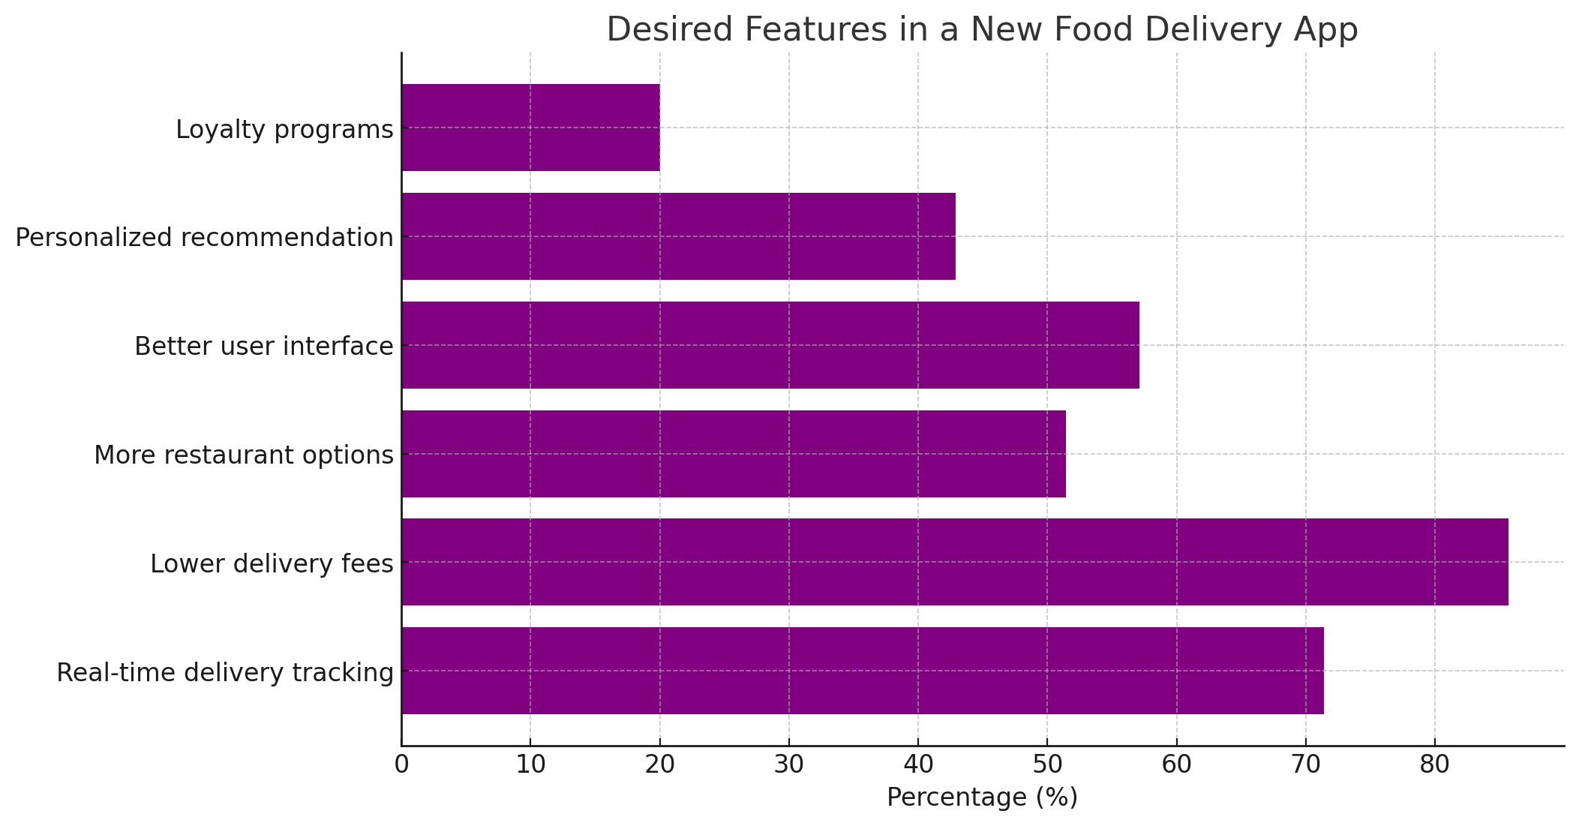
Result from the survey so far

Slide 11
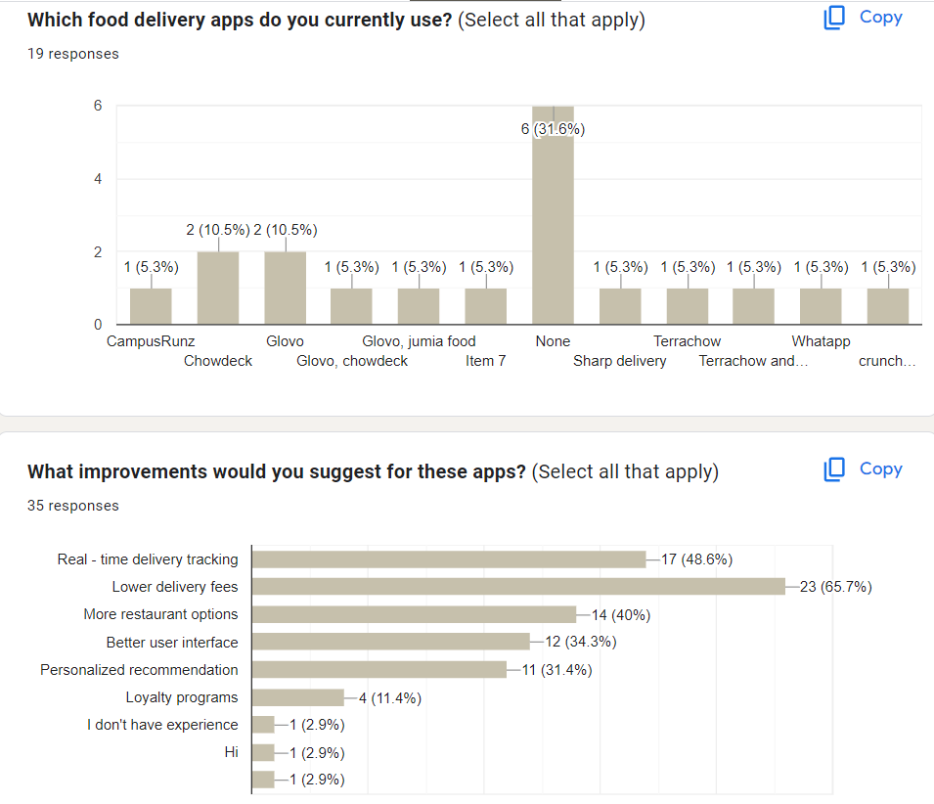

Slide 12
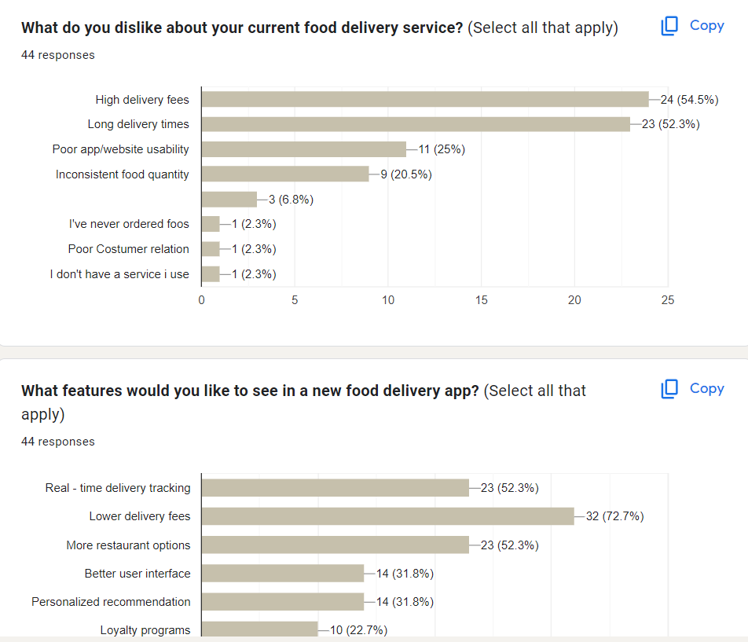

Slide 13
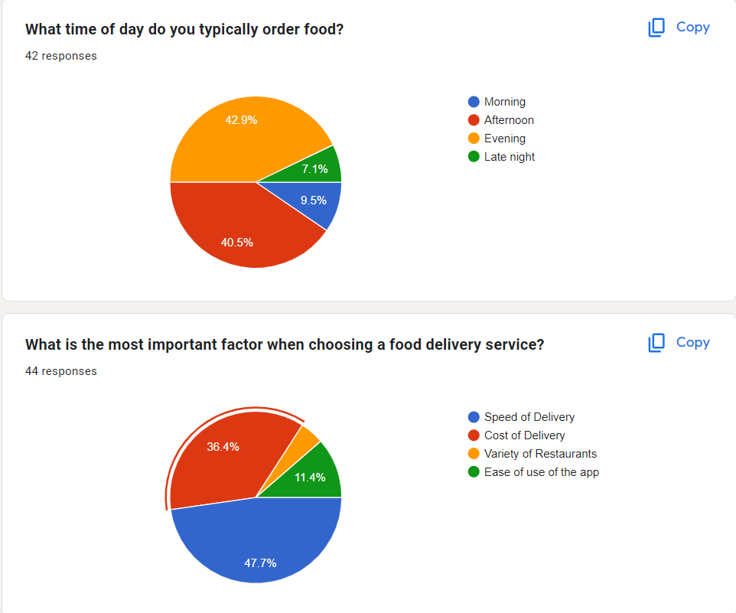

Slide 14
Technology and Platform Development
Key Features
User Experience
User friendly interface
Search and Filtering (Enhanced with AI)
Product Reviews and Ratings
Wishlist and Favorites
Personalized Recommendations(Enhanced with AI)
Seller Features​
Seller Profiles
Product Management
Sales Analytics
Promotion Tools​
Transaction Features
Secure Payment Gateway
Order Tracking
Return and Refund Policy​​​

Slide 15
Partnerships and Logistics
Restaurant Partnerships
We focus on building strong relationships with local restaurants by offering them a platform to reach a wider audience, providing marketing support, and ensuring a seamless partnership experience.
Delivery Fleet
Our delivery fleet is composed of carefully recruited and trained personnel who ensure timely and efficient deliveries, maintaining the highest standards of professionalism.

Slide 16
We provide a responsive customer support system available through multiple channels, ensuring that any issues or inquiries are addressed promptly and efficiently."
We provide a responsive customer support system available through multiple channels, ensuring that any issues or inquiries are addressed promptly and efficiently."
Operations and Customer Service
Operational Workflow
From order placement to delivery.
Our operational workflow ensures a seamless process from the moment an order is placed until it is delivered. This includes order confirmation, restaurant preparation, dispatching a delivery partner, and real-time tracking until the customer receives their food.
Customer Support and feedback
We provide a responsive customer support system available through multiple channels, ensuring that any issues or inquiries are addressed promptly and efficiently
We regularly collect and analyze customer feedback to continuously improve our service, ensuring that we meet and exceed customer expectations

Slide 17
Societal Benefits:
Economic Opportunities: Students can sell homemade goods, second-hand items, and unique crafts, providing them with an additional income source.
Entrepreneurial Skills: The marketplace fosters entrepreneurial skills, encouraging students to create, market, and manage their businesses.
One-Stop Shop: Users can access food delivery services and a diverse marketplace all on one platform, enhancing convenience and saving time.
Support Local Economy: Encourages the circulation of money within the local community, supporting small businesses and local artisans.
Reduce Waste: Students can sell used books, clothes, and other items, promoting recycling and reducing waste.
Eco-Friendly Choices: Users can choose local products, reducing the carbon footprint associated with long-distance shipping.

Slide 18
Best Parts of the Ecommerce Feature:
Unified Platform: Combining food delivery and a marketplace offers a seamless user experience.
User-Friendly Interface: Intuitive design makes it easy for students to list items and for buyers to find what they need
Social Connectivity: The marketplace acts as a social hub where students can interact, share experiences, and support each other's ventures.
Exclusive Campus Deals: Special offers and deals for students create a sense of community and shared benefit.
Increased Engagement: More reasons for users to visit and engage with the platform, driving higher user retention and satisfaction.
Diverse Revenue Streams: Additional revenue from marketplace transactions, increasing the overall profitability of the platform.
The marketplace feature significantly enhances the value proposition of our platform, providing multiple benefits to the community and ensuring higher engagement and profitability.

Slide 19
Business Model
Revenue Streams
Our revenue model includes multiple streams such as delivery fees charged to customers, commissions earned from partner restaurants, and premium services offered to users
Pricing Strategy
We aim to balance competitive pricing with user-friendly and profitability by optimizing our delivery routes and leveraging technology to reduce operational costs.

Slide 20
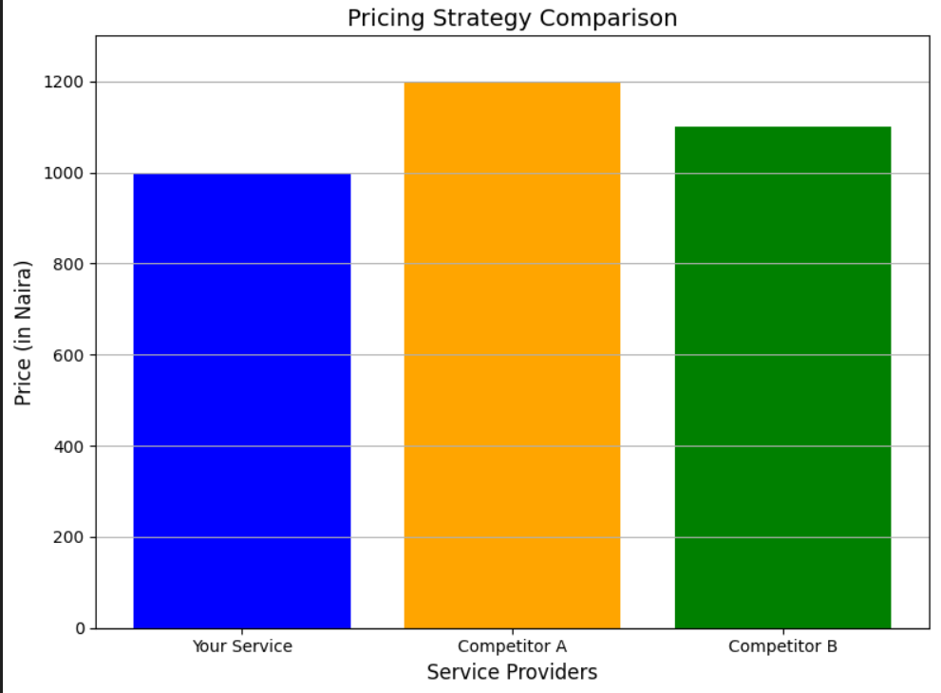

Slide 21
Financial Planning
Budgeting
Initial Investment: ₦8,000,000
Monthly Operating Costs: ₦150,000
Annual Operating Cost: ₦1,800,000
Marketing Budget: ₦500,000
Other Allocations: ₦193,500
Contingency Fund: ₦6,006,500
Funding Requirements
Total Investment Needed: ₦8,000,000, remember this is just a rough estimation
This investment covers all the essential expenses, ensuring the business runs smoothly and is poised for growth.

Slide 22
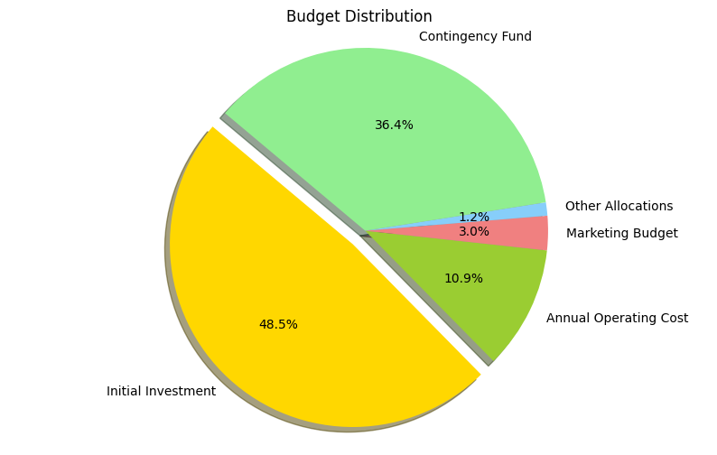
Financial Projections
Revenue and Expense Projections for the Next 1-3 Years
Total Annual Gain: ₦8,373,597 (including remaining investment)
Return on Investment (ROI): 104.67%
Break-Even Point: Approximately 0.96 years
Investor's Annual Gain: ₦1,256,039.55 (15% of total gain)
Developer's Annual Gain: ₦7,117,557.45 (85% of total gain)

Slide 23
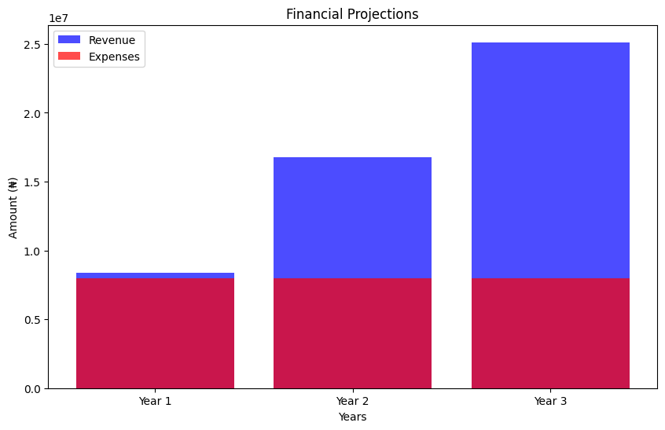

Slide 24
Market Strategies for Engagement
Interactive Food Preferences Quiz:
Concept: Allow users to take a fun and quick quiz to discover their food personality. Based on their answers, the app can recommend specific dishes or restaurants that match their preferences. This personalizes the experience and makes ordering more engaging.
Engagement: People love quizzes that tell them something about themselves. It creates a sense of discovery and can also be shared on social media, attracting new users.
Exclusive Features for Students:
Group Ordering: Introduce a group ordering feature where multiple students can join one order, splitting the cost and delivery fee. This encourages more frequent use and makes it easier for friends to order together.
Student-Only Discounts: Offer discounts exclusively to students who verify their status with a school email or ID. This can make your platform more appealing compared to other services that don’t offer such targeted discounts.

Slide 25
Flash Deals and Happy Hours:
Concept: Implement time-limited flash deals or happy hours where users can get special discounts if they order within a certain time frame. These could be daily deals or pop-up offers that encourage spontaneous orders.
Engagement: This creates a sense of urgency and excitement, motivating users to check the app regularly to catch these deals.
Loyalty and Referral Programs:
Referral Bonuses: Implement a referral program where students earn credits for each friend they refer who makes an order. This not only encourages word-of-mouth promotion but also helps in rapidly growing your user base.
Loyalty Rewards: Offer a loyalty program where students earn points for every order, which can be redeemed for discounts, freebies, or even premium membership that offers perks like priority delivery during peak hours.
Student Ambassadors and Micro-Influencers:
Concept: Partner with popular students or micro-influencers on campus to promote your app. These ambassadors could create content, host events, or run contests that encourage their followers to use the app.
Engagement: Peer influence is strong, especially among students. Having trusted voices on campus advocating for your service can significantly boost engagement and trust.

Slide 26
Partner with Student Organizations and Events:
Event Sponsorship: Sponsor or collaborate with student events, such as club meetings, sports events, or cultural festivals. You can provide food discounts or offer to cater these events through your platform, thus directly showcasing your service to large groups of students.
Collaborative Promotions: Partner with student organizations for co-branded promotions. For example, you could team up with the student council to offer exclusive discounts during exam periods or sponsor a club event where you provide snacks or meals via your platform.
Local Food Challenges and Events:
Concept: Organize food challenges or virtual events where users can participate by ordering specific dishes or from particular restaurants. Winners could receive free meals or be featured on the app’s leaderboard.
Engagement: Challenges and events create a community feel and give users a reason to interact with the app beyond just ordering food.
AR Menu Previews:
Concept: Use Augmented Reality (AR) to allow users to preview dishes before they order. They can point their phone at a flat surface, and the dish appears in 3D, giving them a better idea of portion sizes and presentation.
Engagement: This innovative feature adds a fun, high-tech twist to the ordering process, making your app stand out from competitors.

Slide 27
Launch with a Campus-Wide Event:
Free First Delivery Day: Kick off your service with a "Free First Delivery Day." For one day, all students can order from any restaurant on the platform with no delivery fee. This will encourage them to try the service, and once they experience the convenience, they are more likely to become regular users.
Pop-Up Stands and Live Demos: Set up pop-up stands across campus where students can learn about the app, sign up, and even receive discounts or freebies. Incorporate live demos of the app to show how easy it is to use. Offer small, instant rewards like discount vouchers for their first order or branded merchandise.
Gamification:
Order Challenges: Implement gamification elements like "Order Challenges" where students earn badges or rewards for completing certain tasks, like ordering from different restaurants or hitting a certain number of orders in a month.
Leaderboard Competitions: Create leaderboards where students can compete for top spots based on the number of orders, the variety of restaurants they order from, or the size of their groups. Top students can win rewards like free meals or exclusive experiences.

Slide 28
Unique Feature: Personalized Food Selection for Specific Goals
Concept Overview:
Your platform will include a unique feature that categorizes food based on specific health and fitness goals, such as gaining muscle, losing weight, or achieving a flat tummy. When students log into the app, they can select their fitness goal, and the platform will automatically recommend meals that align with these objectives. This personalized approach not only enhances the user experience but also taps into the growing trend of health-conscious eating.

Slide 29
Key Elements of the Feature:
Personalized Recommendations:
User Profile Setup: During registration, students can input their fitness goals. This information is then used to tailor their food recommendations.
Dynamic Menu Selection: The app will dynamically generate a list of meals from partner restaurants that match the user's goals, making it easy for them to choose the right meal.
Health Benefits Visualization:
Nutritional Breakdown: Each recommended meal will come with a detailed nutritional breakdown, showing how it contributes to the user’s goals (e.g., protein content for muscle gain, calorie count for weight loss).
Progress Tracking: Users can track their progress over time, encouraging repeat orders and long-term engagement.
Engagement and Gamification:
Challenges and Rewards: Introduce challenges such as "30-Day Flat Tummy Challenge" or "Muscle Gain Marathon," where students can win rewards (like discounts or free delivery) by sticking to their personalized meal plan.
Social Sharing: Encourage users to share their progress on social media, creating a community around health and fitness that also promotes the platform.
Note: Integration with Campus Activities:
Partner with campus gyms, sports teams, and health clubs to promote the app. Offer special discounts or meal plans tailored to athletes and fitness enthusiasts.

Slide 30
Proposed Partnership with School Hospital
Objective: The goal of this partnership is to leverage the school's healthcare system to promote the health benefits of our food delivery app. By working together, we can provide students with tailored meal plans that not only satisfy their cravings but also contribute to their overall well-being.
Benefits to the School Hospital:
Promote Healthy Lifestyles:
Our app features a unique section that categorizes foods based on specific health goals, such as gaining muscle, losing weight, or achieving a flat tummy. The app automatically selects meals that align with these goals.
The hospital can use this feature to recommend the app to students as a tool for maintaining a healthy diet, which aligns with the hospital's mission to promote wellness on campus.
Increased Awareness of Health Services:
By partnering with us, the school hospital can raise awareness of its own services. The app can feature educational content about healthy eating
habits, created in collaboration with the hospital, which directs students to hospital resources for further support.
Joint Health Campaigns:
We can collaborate on health campaigns that encourage students to make healthier food choices. For instance, during National Nutrition Month, we could launch a campaign together that highlights the importance of balanced meals, with the hospital providing expert advice and endorsements.

Slide 31
Promotion and Visibility:
Hospital-Endorsed Meal Plans:
Meals recommended by the app could come with a "Hospital-Approved" badge, adding credibility and encouraging students to make healthier choices. This endorsement can be a strong selling point, showing that our offerings are not just convenient but also health-conscious.
In-App Advertising and Notifications:
The hospital could advertise its services through our website, reaching a targeted audience of health-conscious students. We can send out notifications about hospital events, such as free health screenings, directly to our users.
Collaborative Content Creation:
We could work together to create content such as articles, videos, or webinars on topics like "Eating Right During Exams" or "How to Maintain a Balanced Diet in College." This content can be featured in the app and on the hospital's website, driving traffic to both platforms.
Implementation Strategy:
Initial Meeting and Proposal Presentation:
Schedule a meeting with the hospital administration to present this proposal. Highlight the mutual benefits and how this partnership aligns with the hospital's mission to promote student health.
Pilot Program:
Start with a pilot program where the hospital promotes the app to a select group of students. Track the results, gather feedback, and adjust the strategy as needed before rolling it out campus-wide.
Ongoing Collaboration:
Establish regular check-ins to review the partnership's progress, discuss new ideas, and ensure that both parties are benefiting from the collaboration.

Slide 32
Market Strategy Day to Day
Specific Strategy to the Market:
Student-Centric Promotions:
Launch Exclusive Campus Events: Host events or pop-up stands where students can sample food from partner restaurants at a discount. These events will create buzz and drive initial sign-ups.
Digital Presence in Student Communities: Create partnerships with student associations and leverage social media platforms like Instagram and TikTok to reach students directly. Provide special promo codes for first-time users that can be shared among their peers.
Customer Excitement and Interest:
Engaging User Interface:
Personalized Experience: Use data analytics to provide personalized meal recommendations based on user preferences and past orders. This makes the ordering experience more tailored and engaging.
Interactive Features: Include a feature where users can vote for their favorite local dish of the month. The winning restaurant or dish could offer a limited-time discount, creating a fun and interactive experience for customers.
Guaranteeing Student Participation as Delivery Workers:
Peer-to-Peer Referrals: Introduce a “Bring a Friend” program where current delivery workers can earn bonuses by referring fellow students to join as delivery personnel. This will not only help expand the delivery network but also foster a community of workers who know and trust each other.
Flexible Earning Potential: Offer surge pricing during peak hours, allowing delivery workers to earn more when demand is high. Promote this flexibility as a key benefit to potential delivery personnel.

Slide 33
Day-to-Day Operations
Morning (7:00 AM - 11:00 AM):
Preparation and Coordination:
Daily Briefing: Hold a quick virtual meeting with delivery personnel to discuss the day's expected volume, key areas of focus, and any special instructions from restaurants.
Order Scheduling: Restaurants upload their daily menu offerings and any special promotions onto the platform. This information is pushed to the website, updating users about what’s available for the day.
Midday (11:00 AM - 2:00 PM):
Peak Order Processing:
Lunch Rush Management: The system prioritizes orders based on proximity and prep time. Delivery personnel are strategically placed near high-demand areas (e.g., campus dining halls) to ensure quick pickups and deliveries.
Real-Time Monitoring: A dedicated team monitors deliveries to ensure that any issues (e.g., delays, traffic) are promptly addressed. Communication is key to maintaining service quality during busy periods.
Afternoon (2:00 PM - 5:00 PM):
Customer Feedback and Engagement:
Review Requests: After lunch, customers receive a prompt to rate their experience. Positive reviews are shared with restaurants and delivery personnel as encouragement.
Data Analysis: The team reviews order data from the lunch rush to identify any patterns, such as popular dishes or frequent issues, and adjusts operations accordingly.

Slide 34
Evening (5:00 PM - 9:00 PM):
Dinner Service and Promotions:
Dinner Rush Preparation: Similar to lunch, the system prepares for another peak period. Special evening promotions or meal bundles are pushed to users, enticing them to order dinner through the platform.
End-of-Day Wrap-Up: Once the dinner rush is over, delivery personnel submit any remaining receipts or reports. The team compiles a daily performance summary, noting any areas for improvement.
Late Evening (9:00 PM - 11:00 PM):
Post-Operational Tasks:
Financial Reconciliation: Payments are processed, with commissions deducted from restaurant sales and payments issued to delivery personnel.
Customer Engagement: A post-day email is sent to customers with a summary of the day's top dishes, upcoming promotions, and any loyalty rewards they’ve earned.

Slide 35
Restaurant Partnerships
In our business model, successful collaboration with restaurants is crucial for our food delivery platform's success. We’ve developed a comprehensive strategy to persuade restaurants to partner with us, focusing on the benefits and day-to-day operations that will make this partnership mutually beneficial.
5% Per Order Proposal:
To justify the 5% commission on each order, we offer several advantages that directly benefit the restaurants:
Exclusive Promotions:
Value Proposition: By partnering with us, restaurants gain access to exclusive promotional opportunities tailored to the student market. We’ll allow them to create special deals or discounts that are only available through our platform. This targeted promotion helps drive more traffic and increases order volume, offsetting the 5% commission.
Broader Audience Reach: Through our marketing channels, we will amplify these promotions, ensuring that the restaurant reaches a broader audience, particularly the student demographic. This exposure can lead to higher sales volumes, which is a strong incentive for the restaurant to agree to the 5% fee.
Visibility and Marketing:
Enhanced Restaurant Exposure: Restaurants that partner with us will be featured prominently in our app, website, and marketing campaigns. This includes social media promotions, in-app banners, and email newsletters that specifically highlight their offerings.
Justification for Commission: By providing this level of visibility, we position the 5% commission as an investment in marketing rather than just a fee. The increased exposure will likely lead to more orders, making the commission worthwhile.

Slide 36
Day-to-Day Operations Proposal:
To ensure smooth operations and maximize the benefits for our restaurant partners, we have established a structured day-to-day engagement plan:
Regular Check-Ins:
Dedicated Relationship Manager: Each restaurant will be assigned a relationship manager who will serve as their primary point of contact. This manager will conduct regular check-ins to discuss performance, address any issues, and share insights on how to optimize their presence on our platform.
Proactive Communication: By maintaining consistent communication, we demonstrate our commitment to the partnership, making restaurants feel supported and valued. This ongoing relationship is key to sustaining the partnership long-term.
Performance Metrics:
Detailed Reports: We will provide restaurants with regular reports on their performance, including sales data, customer feedback, and other key metrics. These reports will offer insights into customer preferences, peak ordering times, and popular dishes.
Data-Driven Growth: With this information, restaurants can make informed decisions to improve their offerings, tailor their menu, and increase efficiency. By showing the value of this data, we can reinforce the benefits of our partnership.

Slide 37
Benefits to Restaurants:
When proposing this partnership to restaurants, we’ll highlight several key benefits that make our platform an attractive option:
Increased Sales Volume: With exclusive promotions and enhanced visibility, restaurants can expect a higher volume of orders, especially from the student demographic, which is our primary target audience.
Targeted Marketing: Our platform's marketing efforts are focused on driving traffic to our partners. Restaurants will benefit from targeted campaigns designed to attract students who are likely to become repeat customers.
Data-Driven Insights: Restaurants will have access to valuable data that can help them refine their menu, optimize pricing, and improve customer satisfaction.
Ongoing Support: The dedicated relationship manager ensures that restaurants receive continuous support, making it easier for them to navigate the partnership and maximize their success on our platform.
Suggestions for Improvement:
Dynamic Pricing Strategies: Consider introducing dynamic pricing options for restaurants, allowing them to adjust prices during off-peak hours or for specific promotions. This can help smooth demand and increase order volumes during slower periods.
Integration with Restaurant POS Systems: Streamlining the order process by integrating our platform with the restaurant’s point-of-sale (POS) systems can reduce errors and improve efficiency, making the partnership more attractive to restaurants.
Customer Loyalty Programs: Implementing a loyalty program that rewards customers for repeat orders from specific restaurants can drive customer retention, benefiting both the restaurant and our platform.

Slide 38
Delivery System Support
Flexible Work Schedules
Appeal: Emphasize that the delivery jobs offer flexible hours, allowing students to work around their class schedules, extracurricular activities, and study times.
Implementation: Develop a user-friendly scheduling system within the app that allows students to select shifts that fit their availability. Highlight this feature as a key benefit in your recruitment campaigns.
Competitive Pay and Incentives
Appeal: Ensure that the pay is competitive and includes performance-based incentives such as bonuses for high delivery volumes, on-time deliveries, and positive customer feedback.
Implementation: Create a transparent payment structure that students can easily track through the app. Introduce a rewards program where top performers receive bonuses, gift cards, or extra time off.
Work-Study Integration
Appeal: Partner with the university to offer the delivery job as part of a work-study program. This would allow students to earn money while gaining practical experience that could be relevant to their future careers.
Implementation: Collaborate with the university's career services to formalize the delivery roles as work-study positions. Offer training that includes customer service skills, time management, and logistics management, which are valuable in various career paths.

Slide 39
Community and Social Aspects
Appeal: Build a sense of community among student delivery partners by organizing social events, team-building activities, and providing them with branded merchandise (like T-shirts or caps) that create a sense of belonging.
Implementation: Regularly host events such as "Delivery Partner Meetups" where students can share experiences, provide feedback, and socialize. Also, introduce a referral program where students can earn bonuses for bringing in friends to join the delivery team.
Health and Safety Assurance
Appeal: In the post-pandemic era, health and safety are top concerns. Ensure that students feel safe while working by providing them with PPE (Personal Protective Equipment) and offering health benefits.
Implementation: Offer free health checkups in partnership with the school hospital and provide a hotline for any health or safety concerns. Regularly update safety protocols and communicate them clearly to all delivery partners.
Partnership with School Hospital
Appeal: Leverage the relationship with the school hospital to promote the health benefits of the delivery job. For instance, the physical activity involved in delivery work can be framed as a way to stay fit.
Implementation: Develop a marketing campaign in collaboration with the school hospital, highlighting the physical and mental health benefits of being a delivery partner. The hospital can also help in organizing health workshops or fitness challenges for the student workers.

Slide 40
Tech-Enabled Efficiency
Appeal: Show students that the job is not only easy but also tech-savvy, appealing to their familiarity with technology.
Implementation: Use an intuitive app that makes managing deliveries, navigating routes, and tracking earnings simple and efficient. Include features like live GPS tracking, real-time customer communication, and instant payment processing to enhance their experience.
Academic Support
Appeal: Offer academic support to student workers, such as tutoring sessions or access to study resources, to show that you care about their academic success as much as their work performance.
Implementation: Partner with academic tutoring services or provide discounted access to study materials and resources. This could be marketed as a perk of being part of the delivery team.
Feedback and Growth Opportunities
Appeal: Students will be more likely to engage if they feel their voice is heard and they have opportunities for growth.
Implementation: Create a feedback loop where student workers can suggest improvements and feel their contributions are valued. Offer opportunities for advancement within the company, such as team leader positions or internships in logistics management.

Slide 41
. Marketing Strategy for Student Recruitment
Campus Events: Host recruitment events on campus, where students can sign up on the spot, learn more about the job, and interact with current delivery partners.
Social Media Campaigns: Use targeted ads on platforms like Instagram and TikTok, emphasizing the flexibility, competitive pay, and community aspects of the job.
Collaborations with Student Organizations: Partner with student organizations to promote the job opportunities, leveraging their networks to reach more students.
Conclusion
By addressing students' needs for flexibility, fair compensation, community, and academic support, and by leveraging the partnership with the school hospital, you can create a highly attractive proposition for students to join the delivery team. Presenting this comprehensive approach to your investors will demonstrate a strong understanding of the target demographic and a well-thought-out plan for ensuring a reliable and motivated delivery system.

